Slide 1
Regional energy regulation: vision and barriers
The EU gas market, regulation and decarbonisation
IX. World Forum on Energy Regulation
Csilla BARTOK, Head of Department
21-24 September 2026

Slide 2
Agenda
EU gas market evolution
  Supply and demand landscape
  Capacity regulation
  Decarbonisation

Slide 3
EU gas market has adapted to changed flows post-2022 …
… , yet market tightness and external shocks can impact price dynamics.
TTF price January 2021-April 2026 (EUR/MWh)
2024-2025
A period of stabilisation and consolidation, during which price volatility eased despite the remaining uncertainty.
Infrastructure upgrades to pipelines and LNG terminals reduced bottlenecks and congestion, improving flexible routing across the EU.
2022-2023
A volatile and high price period characterised by the mismatch between supply and demand.
Disruption of Russian gas supplies call for the restructuring of gas supplies, leading to flows reconfiguration with pressure points on the gas network (increasing congestion).
2026
New period of price volatility due to external shock factors (Strait of Hormuz closure). Due to the increased supply flexibility provided by the LNG, the impact for now is rather modest.
Source: ACER based on ICIS.

Slide 4
Supply diversification drives flows’ reconfiguration
… while the EU is left more vulnerable to global price volatility and transport disruptions
EU gas consumption evolution 2017-2025 (bcm) and share of gas supply imports in 2021 and 2025 (%)
Demand reduction regulation adopted in August 2022
Lower demand and a higher share of LNG in the supply mix have helped overcome the bottlenecks observed in 2022–2023, overall contributing to reduced system utilisation*.
In the long term, decarbonisation trends are likely to further decrease demand and hence infrastructure use.
Source: ACER based on Eurostat, JRC, ENTSOG, ICIS.
* More details can be found in ACER’s report on capacity use and booking trends in European natural gas markets.

Slide 5
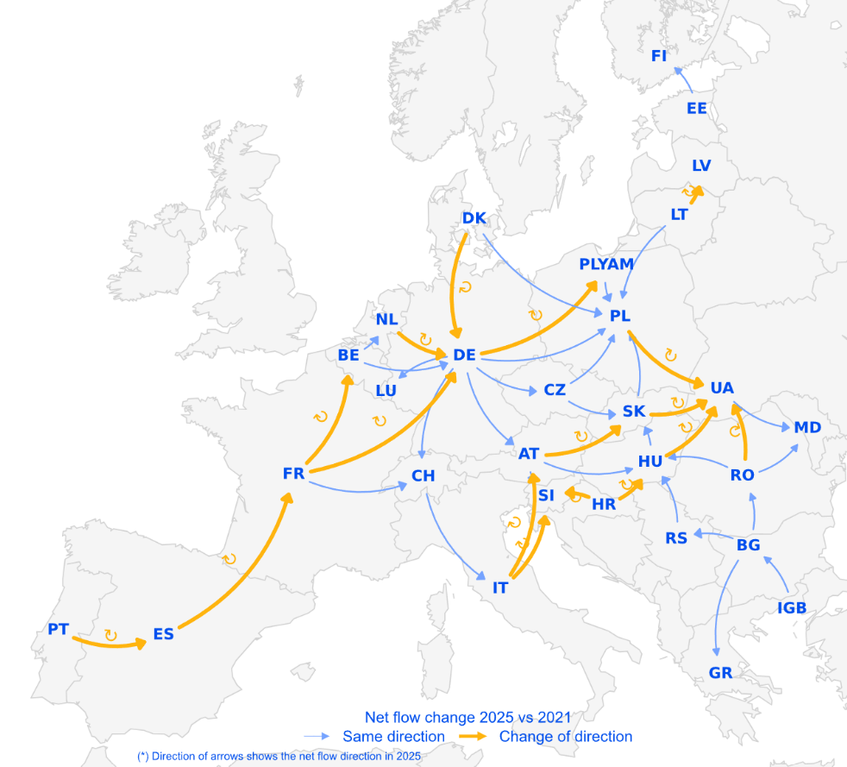
The interconnected market supported the gas flow shifts
Gas flow reconfiguration still ongoing: From west-to-east to east-to-west, and from coastal hubs to landlocked regions
Changes** to net transmission
network gas flows, 2025 vs 2021
  Optimising network capacity and upgrading infrastructure, including new LNG terminals and pipeline reinforcement, has been critical to managing reconfigurations.
  Around 40% of interconnection points have changed flow direction between 2021 and 2025.
  Aggregated booked capacity* is adapting to the market dynamics and has dropped by about one third in the EU between 2021 and 2025.
Source: ACER based on ENTSOG and JRC’s eurogastp Python package. *More details on booking behaviours can be found in ACER’s report on capacity use and booking trends in European natural gas markets (October 2025). **The aggregation of cross-border gas flows is based on tailored strategies that generate timeseries for each edge of the target topology using JRC’s eurogastp Python package. Low-calorific gas flows and pipelines are excluded from this analysis. PLYAM represents the Polish part of the Yamal pipeline.

Slide 6
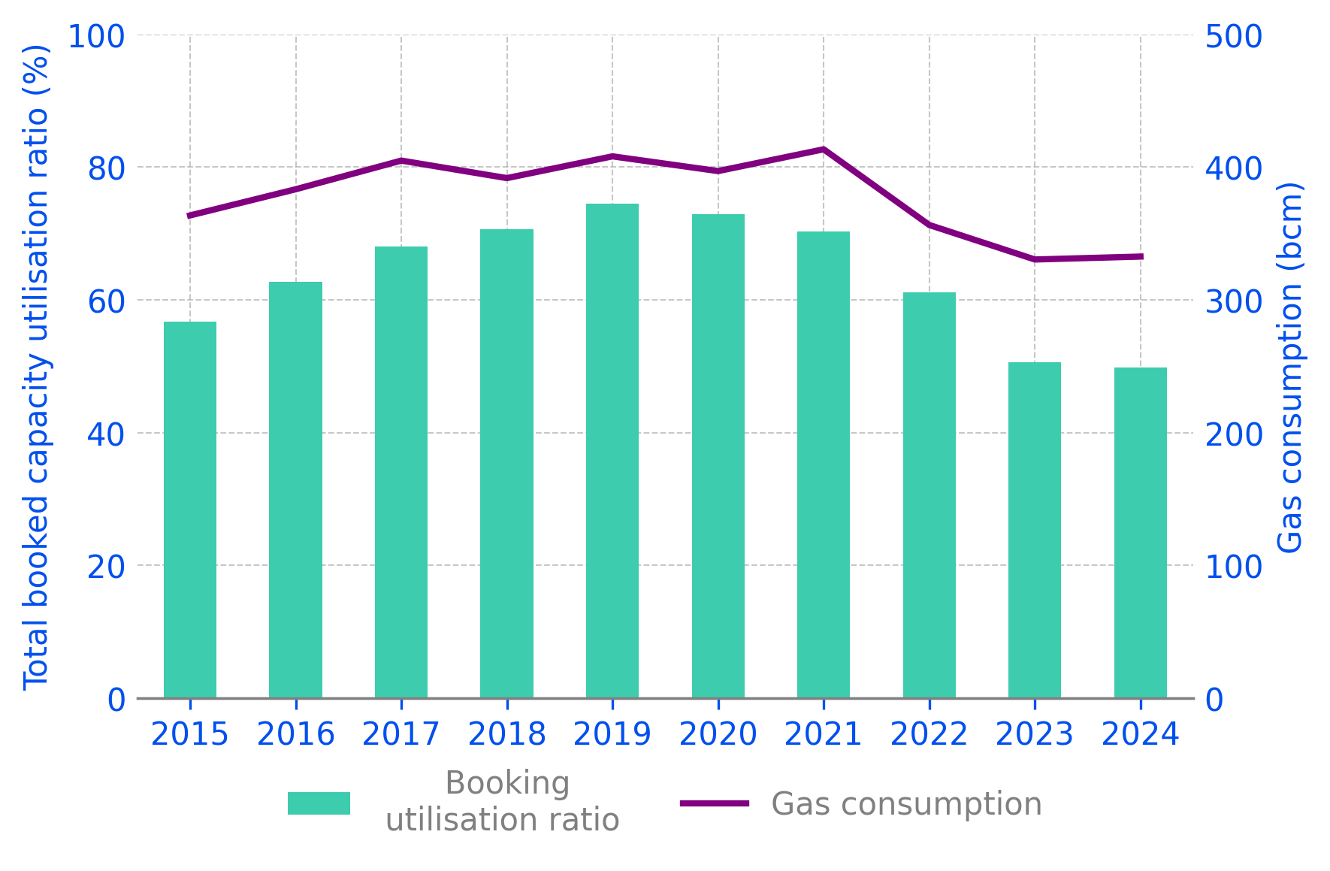
The cross-border network is efficiently used
The utilisation of booked capacity has increased through the implementation of the network code (Capacity Allocation Mechanisms Network code) and decreased post-2022 due to changed market fundamentals
Annual booked capacity utilisation ratio (%) and EU27 gas consumption (bcm) - 2015-2024
  Increasing booking efficiency can help reduce the costs paid by network users.
  Cross-border capacity allocation has progressively improved booking efficiency: auctions gradually took over legacy capacity contracts.
  The energy crisis significantly disrupted this trend, notably due to the reallocation of capacity resources.
Source: ACER based on Eurostat and ENTSOG.
Note: Booked capacity utilisation has been computed as the ratio between the annual physical flow and the annual booked capacity reported by ENTSOG only at CAM-relevant interconnection points

Slide 7
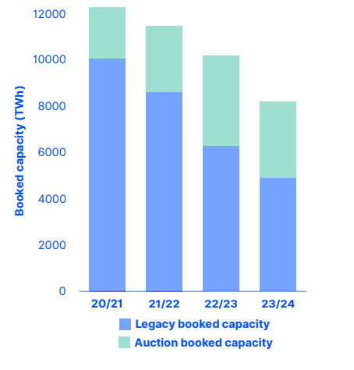
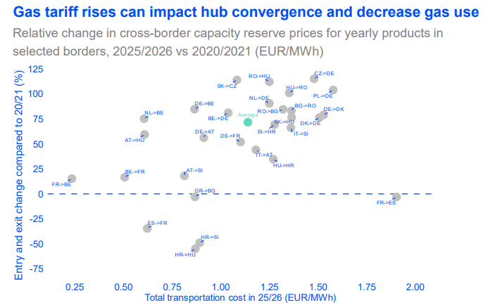
Capacity utilisation decreased and tariffs increased
Booked capacity at EU interconnection points has dropped by one third since 2020/2021, due to lower demand (-18% since) and shorter-term capacity profiling
Transmission tariffs have increased by 75%*between 2020-2026, driven by lower bookings. Rising tariffs can affect hub price integration and further subdue natural gas demand
Evolution of booked capacity at EU CAM-relevant Interconnection Points (October 2020-September 2024 in TWh)
Relative change in cross-border capacity reserve prices for yearly products at selected borders, 2025/2026 vs 2020/2021 (EUR/MWh)
Source: ACER based on ENTSOG. The relative change refers to the sum of entry and exit reserve price tariffs, excluding potential additional charges and levies (e.g., in Germany). Note 1: 2022 vs 2021 average increase lagged behind inflation, which may indicate also a certain catching up. Note 2: Other factors may offset the trend though. Chiefly, in many EU gas systems amortisation is well advanced, and if investments remain modest, this could mitigate the upward pressure on tariffs in the coming years. CAM NC stands for capacity allocation mechanism network code. *Average of each IP rise across the period.

Slide 8
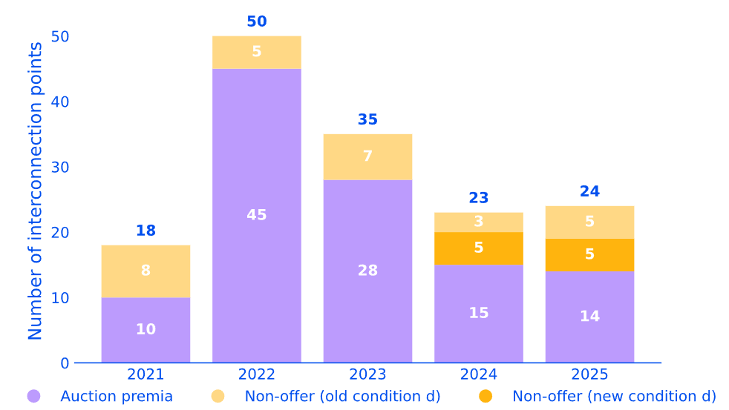
Congestion levels peaked in 2022 and fell post-2023
Identified congestion has decreased but still higher than in 2021
Number of congested interconnection point sides in 2021-2025
Change of legal definition for non-offer congestion status
  Network congestion remains present at key interconnection points on the west-to-east routes and in Southeast Europe.
  In 2024 and 2025, contractually congested entry and exit sides at interconnection points for auction premia have fallen sharply compared to 2022 and 2023 levels, reflecting eased capacity and improved market conditions.
  Congestion revenues recorded by transmission system operators in 2024-2025 stabilise below 2023 levels.
Source: ACER congestion analysis based on data provided by ENTSOG, GSA Platform, PRISMA and RBP. CAM and CMP relevant interconnection points. For its analysis, the ACER relies on data provided by ENTSOG and by the booking platform operators. (ACER is not responsible for their accuracy of the data.)

Slide 9
Gas price spreads have converged since April 2026
All the main European gas hubs are both well correlated and closely convergent
Range between hubs with cheapest and most expensive spot price,
January 2023 – March 2026 (EUR/MWh)
The spread between TTF and Eastern European gas markets is still relatively high
Average spread to TTF, summer 2026 vs summer 2025 until 31 August (EUR/MWh)
Source: ACER based on ICIS data and VERT.
Note: The listed hubs correspond to Austria, Belgium, Czech Republic, France, Germany, Hungary, Italy, Slovakia and Spain Virtual Trading points. Lithuania was added based on day-ahead prices data provided by the NRA.

Slide 10
Capacity allocation mechanism to change
Evolving gas market (and crisis learnings)
Changed use of the gas transmission system due to demand reduction and increased LNG imports offsetting reduced Russian pipeline supplies.
The decarbonisation package
Modify the market rules so they fully advance decarbonisation, facilitate security of supply and facilitate regional cooperation.
Focus on the efficient use of the gas system and its monitoring.
More transparency on how capacity is maximised to be better prepared for handling capacity use
Contribute to a better understanding of the system’s capability when decarbonising it
3. Enabling quick modification of non-essential technical rules.
Keep the level of harmonisation and EU governance
Increasing the dynamic in offering capacity.
Additional auctions (of existing products) and creating product durations between monthly and daily (fitted to delivering an LNG cargo) responds better to handle high volatility and changing supply routes

Slide 11
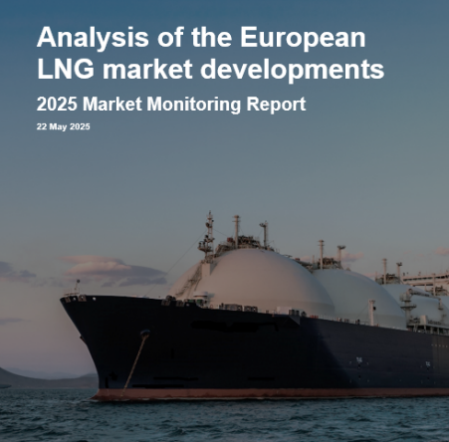
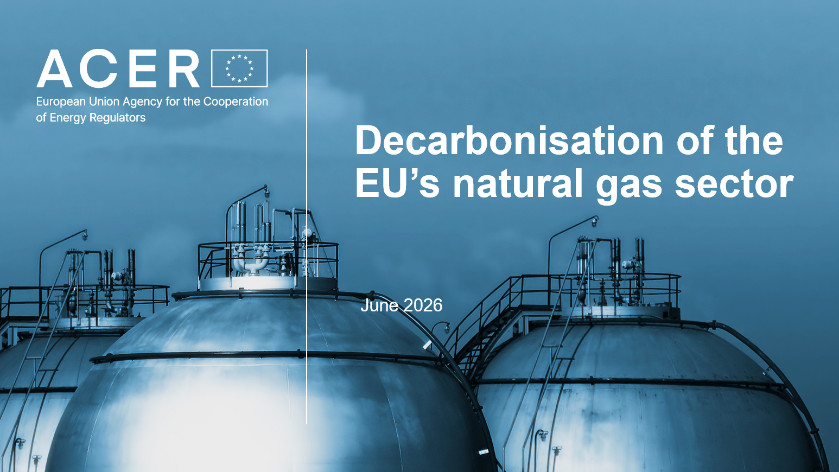

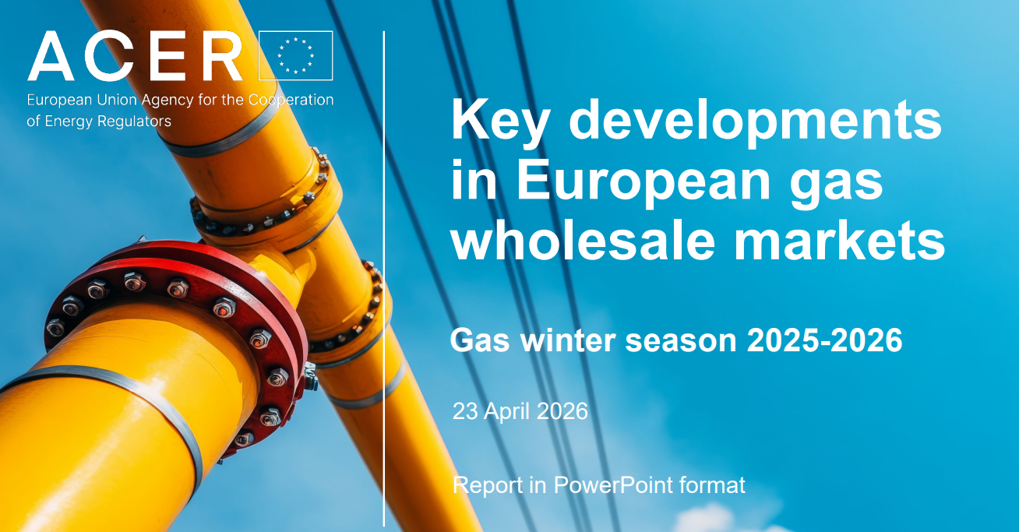

ACER monitoring activities follows the evolution of the market
LNG plays a growing role as a flexible supply source
Mid-term contracted volumes and accelerated decarbonisation will help protect Europe from price volatility
Despite ambitious gas demand-reduction targets, progress has somewhat stalled.
Gas still provides system-flexibility, renewable generation remains weather-dependent and reducing industrial gas demand could affect competitiveness.
Gas decarbonisation will likely rely not only on electrification, but also on a mix of mature and emerging technologies, including biomethane, hydrogen, carbon capture and storage.
Greater exposure to global LNG markets exposes Europe to global price volatility and disruptions
The Middle East crisis intensified competition for spot cargoes and may impact reaching storage targets for the next winter
Coming soon: ACER Hydrogen Market Monitoring Report (October 2026) assessing sector developments and main regulatory and market challenges for the EU.

Slide 12
Decarbonisation
Renewables and biomethane

Slide 13
EU gas demand evolution and decarbonisation efforts
Stronger decarbonisation efforts are required to reach the envisaged conventional gas consumption reductions by 2030
Historical gas consumption in the EU, 2014-2025 (bcm) and projected gas consumption under various decarbonization scenarios, 2026-2050 (bcm)
340 bcm, 2025
280 bcm, Fit-for-55 target
16% reduction in total gas consumption in 2025 compared to the five-year average of the reference period 2017-2021
2040 Impact Assessment, European Commission
190 bcm, REPowerEU target
Source: ACER calculations based on Eurostat, EC’s impact assessment for the 2040 climate target, and European Commission’s documents. For further information, the reader is referred to ACER Market Monitoring report on LNG market developments, 2025.
Note 1: Fit-for-55 implies a 32% reduction in natural gas demand compared to 2019, while the most ambitious REPowerEU scenario (without considering the gas savings related to renewable hydrogen targets) projects gas demand 32% below the Fit-for-55 level.

Slide 14
Renewables impact the operation of gas power plants
Gas-fired generation profiles are increasingly exhibiting a duck-curve pattern
Average hourly gas and solar generation profiles, gas winter 2019/20 vs gas winter 2025/26 (GWh)
Gas generation remains mostly constant throughout the day.
Despite being flexible, the operation of gas-fired power plants is constrained by their physical characteristics (e.g. ramps). This inter-temporal coupling may be reflected in their generation offer.
While increasing solar output reduces morning reliance on dispatchable generation, it triggers steep evening ramps as the sun sets and electricity demand spike. This has led to gas power plant generation to exhibit steeper ramps in the evening.
Solar generation crowds out gas generation at central hours
Peak hour demand relies on a larger response slope of gas generation
Source: ACER calculations based on ENTSO-E transparency platform performed for Member States where generation unit level data is available for gas-fired power plants - analyses excludes Estonia, Croatia, Ireland, Malta and Cyprus. Slovakia is also excluded from the analysis due to generation data quality issues.

Slide 15
Biomethane reduces import dependence and geopolitical risk
Gas demand is expected to decrease during the energy transition, and biomethane integration reduces the dependency with external gas suppliers
Gas consumption vs biomethane production potential, 2025-2050 (bcm)
340 bcm in 2025
Gas import dependency (%) vs biomethane production (bcm), 2025-2050
Large gap between biomethane potential and linear projection
Lower uncertainty range of gas consumption by 2050 to comply with net-zero climate target
Theoretical biomethane potential due to economic and technical constraints
Source: ACER based on data from 2040 climate target’s impact assessment of the European Commission, SolarPower Europe, Wind Europe, EHPA, EBA, Shell, and Agora.
Note: On the right plot, import dependency is computed as the share of biomethane and conventional gas production with respect to total gas consumption. Each point represents a year until 2050 based on averages.

Slide 17
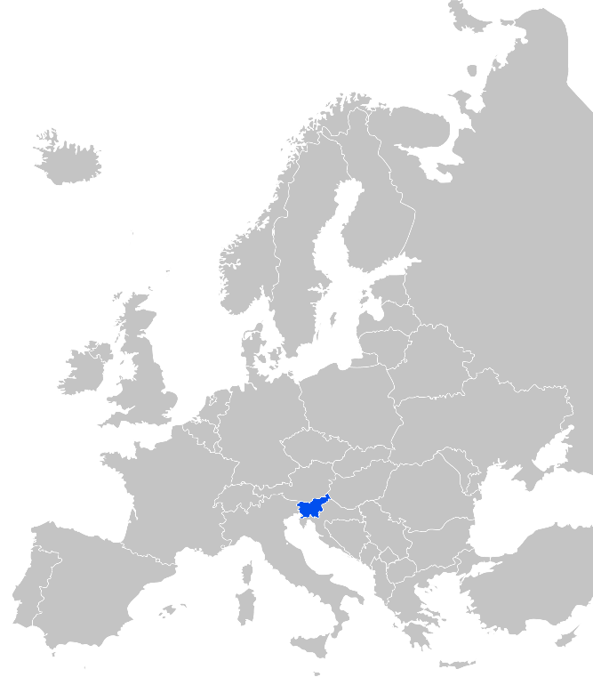
ACER role and governance
Supporting the integration of energy markets in the EU
(by common rules at EU level). Primarily directed towards transmission system operators and power exchanges.
Contributing to efficient trans-European energy infrastructure, ensuring alignment with EU priorities.
Monitoring energy markets to ensure that they function well, deterring market manipulation and abusive behaviour.
Where necessary, coordinating cross-national regulatory action.
Governance: Regulatory oversight is shared with national regulators. Decision-making within ACER is collaborative and joint (formal decisions requiring 2/3 majority of national regulators). Decentralised enforcement at national level.
Headquartered in Ljubljana, Slovenia. Engaged across the EU.

Slide 18
Annexes
For the discussions

Slide 19
Both industry significance and its relative reliance on gas will shape the impacts of decarbonisation
Classification* of Member States based on their share of industrial energy demand and the share of natural gas in final energy consumption
Decarbonisation is challenging for all countries. But it poses greater risks to industrial competitiveness where both industrial importance and gas dependence are high
Countries’ exposure to the energy transition depends on two key factors:
how their economies rely on industry and
how dependent they are on natural gas.
Higher industry – Higher gas
Higher industry – Lower gas
Lower industry – Higher gas
Lower industry – Lower gas
Source: ACER based on Eurostat.
*Countries were classified using two key metrics: the share of industrial energy demand in final energy consumption (threshold: 20%); and share of natural gas in final energy consumption (threshold: 15%).

Slide 20
Carbon pricing is a lever for electricity decarbonisation
Flexibility gap: without alternatives, gas keeps its power
Average annual cost of gas for producing electricity and average day-ahead electricity price, EU-27/EEA (Norway), 2020-2025 (EUR/MWh)
Although gas prices have stabilised in 2024-2025, electricity prices in many gas-dependent countries remain linked to gas market dynamics, particularly during peak hours when renewable output is low and clean flexibility options are limited.
The share of “gas-in-the-money” hours (when gas-fired generation was profitable) has increased compared to the crisis years and remains around 43% for 2025. These hours largely coincide with periods of low solar and wind availability, and gas-fired plants deliver the residual demand.
CO₂ cost
250
Gas cost
Average electricity market price
200
226.88
150
EUR/MWh
100
90.97
81.67
50
69.5
74.78
19.65
2020
2021
2022
2023
2024
2025
Source: ACER calculations based on ENTSO-E Transparency Platform and ICIS. Note 1: The percentage of hours when electricity day-ahead prices were equal to or higher than the cost of generating electricity from gas was calculated. The calculation considered whether at least one bidding zone recorded a day-ahead price equal to or above the gas-based generation cost. Note 2: Gas prices were taken from the most liquid national markets (AT, BE, CZ, DE, ES, FR, HU, IT, NL, PL) where available. For other EU Member States without sufficiently liquid gas hubs, the TTF price was used as a reference benchmark.

Slide 21
Role of methane molecule in energy-sector emissions
Although most domestic and global methane abatement potential is cost-effective, it remains underexploited
Global energy-related methane emissions and EU methane emissions associated with oil and natural gas consumption, 2024 (Mt of methane)
The EU Methane Regulation introduces gradual requirements for EU gas importers, starting with transparency and monitoring, but implementation is constrained by supply-chain complexity, delayed national penalty frameworks, and the need to manage security of supply concerns.
Methane emissions from gas and oil supply chains serving the EU far exceed emissions within EU territory.
EU’s methane mitigation must therefore be addressed as a global decarbonisation challenge.
6%
Source: ACER based on IEA Methane Tracker 2025.
* Methane emissions estimates vary widely across sources. For instance, the IEA estimates that actual methane emissions from the energy sector are around 50% higher than those reported in official inventories, based on satellite and other top-down measurements.

Slide 22
Decarbonisation cornerstones until 2040: key policy measures
1. Sustained electrification of end- consumers and energy efficiency measures
2. Scale-up of renewable and low-carbon gases
Biomethane trading certificates Union Database
Hydrogen Targets: electrolyser capacity, RFNBO industrial use
EU Methane Regulation
CBAM, applying carbon price to imported goods
ETS2 operational launch
(including buildings and transport)
REPowerEU targets: PV, wind, heat pump and biomethane escalate with financial support
EU Zero-Emission Cars
3. Stable policy, carbon pricing, and supportive investment frameworks
4. Large-scale renewable power deployment and system flexibility and integration
Note: The selection is representative only and timelines are non-linear. Each key policy measure comprises a complex and evolving set of rules, targets, and sub-regulations.

